Slide 1
Practical Session: Regression and Classification
Jun Chen
Fujian Institute of Research on the Structure of Matter,
Chinese Academy of Sciences
July 14, 2025

Slide 2
Our goals today:
Familiar with classification and regression
Familiar with SVM/RF/xGB/NN methods
Become an expert in GP/NN PES construction!

Slide 3
Let's form 10 teams (4-6 guys each team) for a machine learning challenge!
Project Requirements
Each team are recommended to complete at lease two tasks:
Regression/Classification: Choose at least one from Exercise 1 or 2.
PES Fitting: Complete GP or NN fitting from Exercise 3 or 4.
Showcase Your Work
Each team will have 3 minutes for a flash talk (3-5 slides) to present results.
Tools & Resources
Recommended: Python (scikit-learn, TensorFlow, PyTorch, etc.).
Alternatives: MATLAB or Fortran are also recommended.
AI Assistance: Feel free to use AI tools (GPT, Gemini, etc.).

Slide 4
Exercise 1: predict the activation energy E_{a} → regression
Exercise 2: predict the activity of catalyst → classification
Exercise 3: potential energy surface using Gaussian Process
Exercise 4: potential energy surface using Neural Networks
all materials can be found in:
google drive: MLAI for Molecular Science Summer 2025 / Day 1 / practical_section_7.14
or
https://github.com/njuchenjun/nyu_summer_school_2025 → practical_section_7.14.tar

Slide 5
Exercise 1: predict the activation energy E_{a} → regression

Slide 6
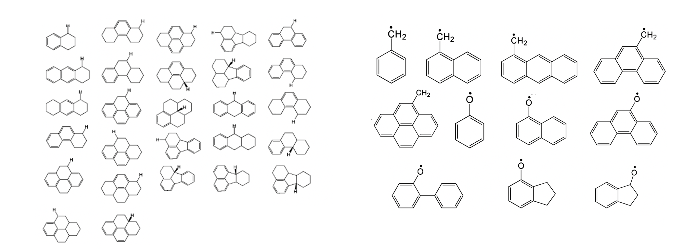
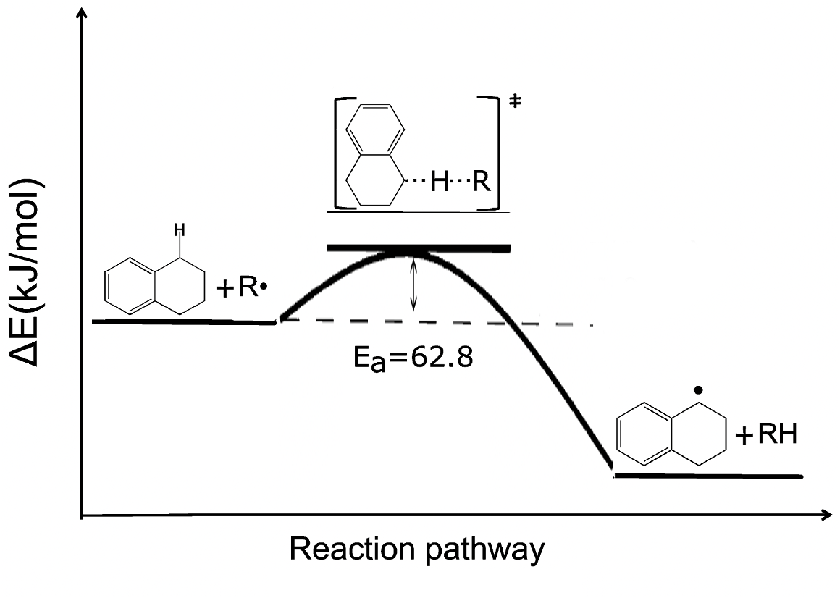
Exercise 1: predict the activation energy E_{a} → regression
H·
Ra + Rb → TS → Pa + Pb
the Ra set
the Rb set
task 1: prepare of dataset. Structure of Ra and Rb -> RDkit (SMILES, …) -> features (xlsx file)
task 2: predict E_{a} of the TS. Features of Ra and Rb -> ML models -> E_{a} labels

Slide 7
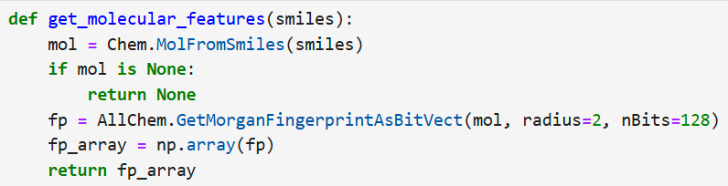
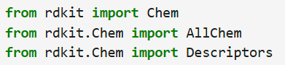
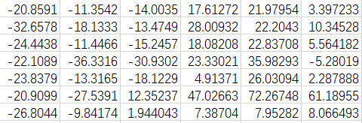
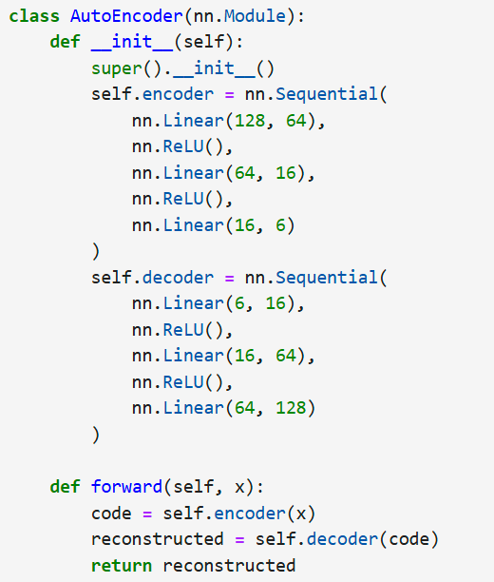
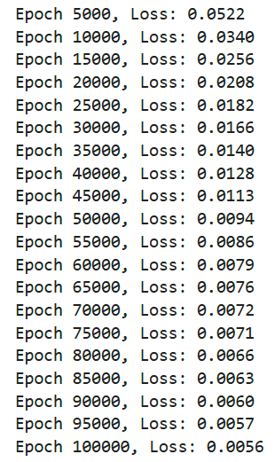
Exercise 1: predict the activation energy E_{a} → regression
descriptors type I:
physical chemistry knowledge
descriptors type II:
microscopic structure
Morgan fingerprint of molecule
BDE_A, BDE_B: Bond dissociation free energy
V_A, V_B: Molecular volume
BertzCT_A, BertzCT_B: Bertz complexity index, describing the molecule’s topological complexity
κ_A, κ_B: Molecular shape descriptors
NOcount: Number of nitrogen (N) and oxygen (O) atoms
N_Ar_R: Number of aromatic rings
N_Sat_C: Number of saturated rings
H_K_α_A, H_K_α_B: Hall–Kier α values, describing the molecule’s topological polarity
Out:
AutoEncoder
128D -> 6D
Descriptor augmentation and training

Slide 8
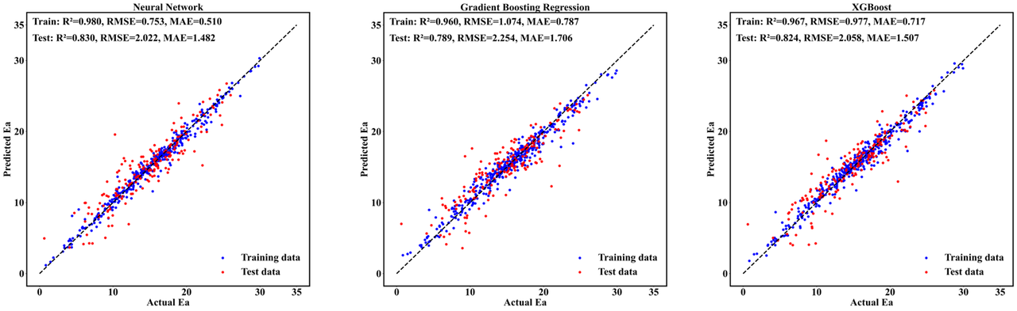
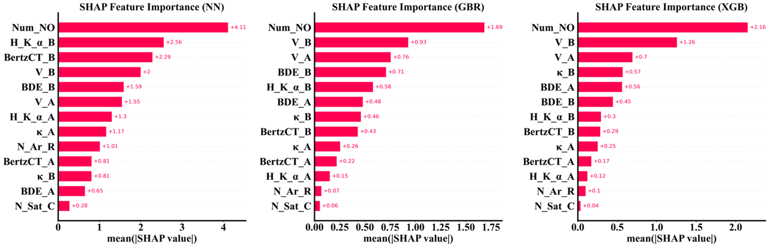
Exercise 1: predict the activation energy E_{a} → regression
Neural Network
Gradient Boosting Regression
XGBoost
SAMPLE RESULTS

Slide 9
Exercise 2: predict the activity of catalyst → classification

Slide 10
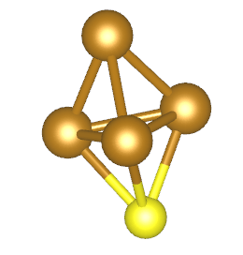
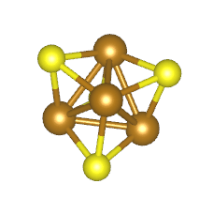
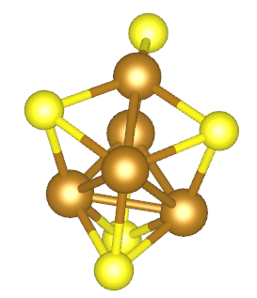
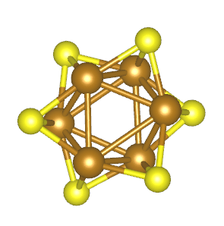
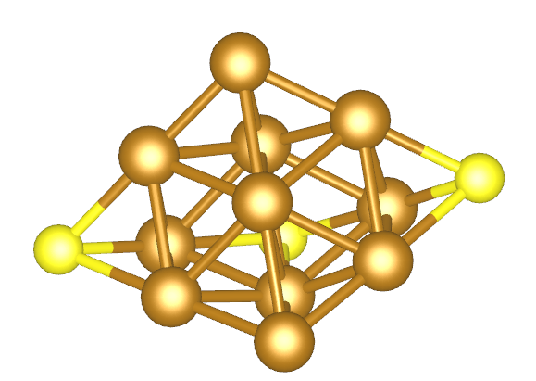
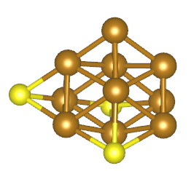
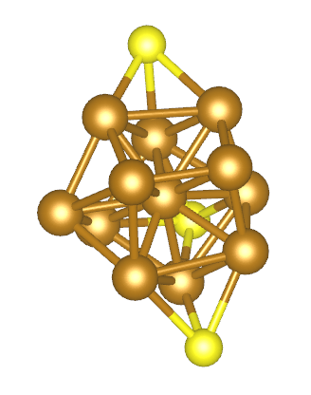
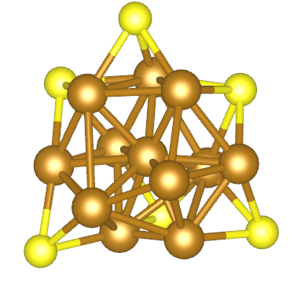
Ra - H -> Pa
Rb + H -> Pb
Exercise 2: predict the activity of catalyst → classification
H·
Ra + Rb → TS* → Pa + Pb
Assuming the previous gas-phase reaction occurs on a metal cluster catalyst (heterogeneous catalysis model), can the transition state energy barrier be lowered?
Our goal: to find the optimal Ra/Rb/catalyst combination that facilitates the HAT (H atom transfer) reaction most easily.
the catalyst set
Fe₄S
Fe₄S₄
Fe₅S₅
Fe₆S₆
Fe₁₁S₃
Fe₁₀S₃
Fe₁₂S₃
Fe₁₂S₆

Slide 11
Exercise 2: predict the activity of catalyst → classification
H·
Directly calculating the energy barrier for the Ra+Rb reaction on a cluster is somewhat difficult, but we can assume the reaction energy barrier is determined by these factors:
The process of Ra losing a hydrogen atom to form Pa;
The process of Rb gaining a hydrogen atom to form Pb;
The electronic structure properties of the cluster.
Ra + Rb → TS* → Pa + Pb
simplified
as:
Ra → Pa + H·(ads)
Rb + H·(ads) → Pb
the structure of cluster
task 1: Prepare of dataset. Structures -> RDkit (SMILES, …) -> features (xlsx file)
task 2: Make labels. TS of HAT processes (the elementary reaction).
task 3: Features -> ML models -> goodness labels

Slide 12
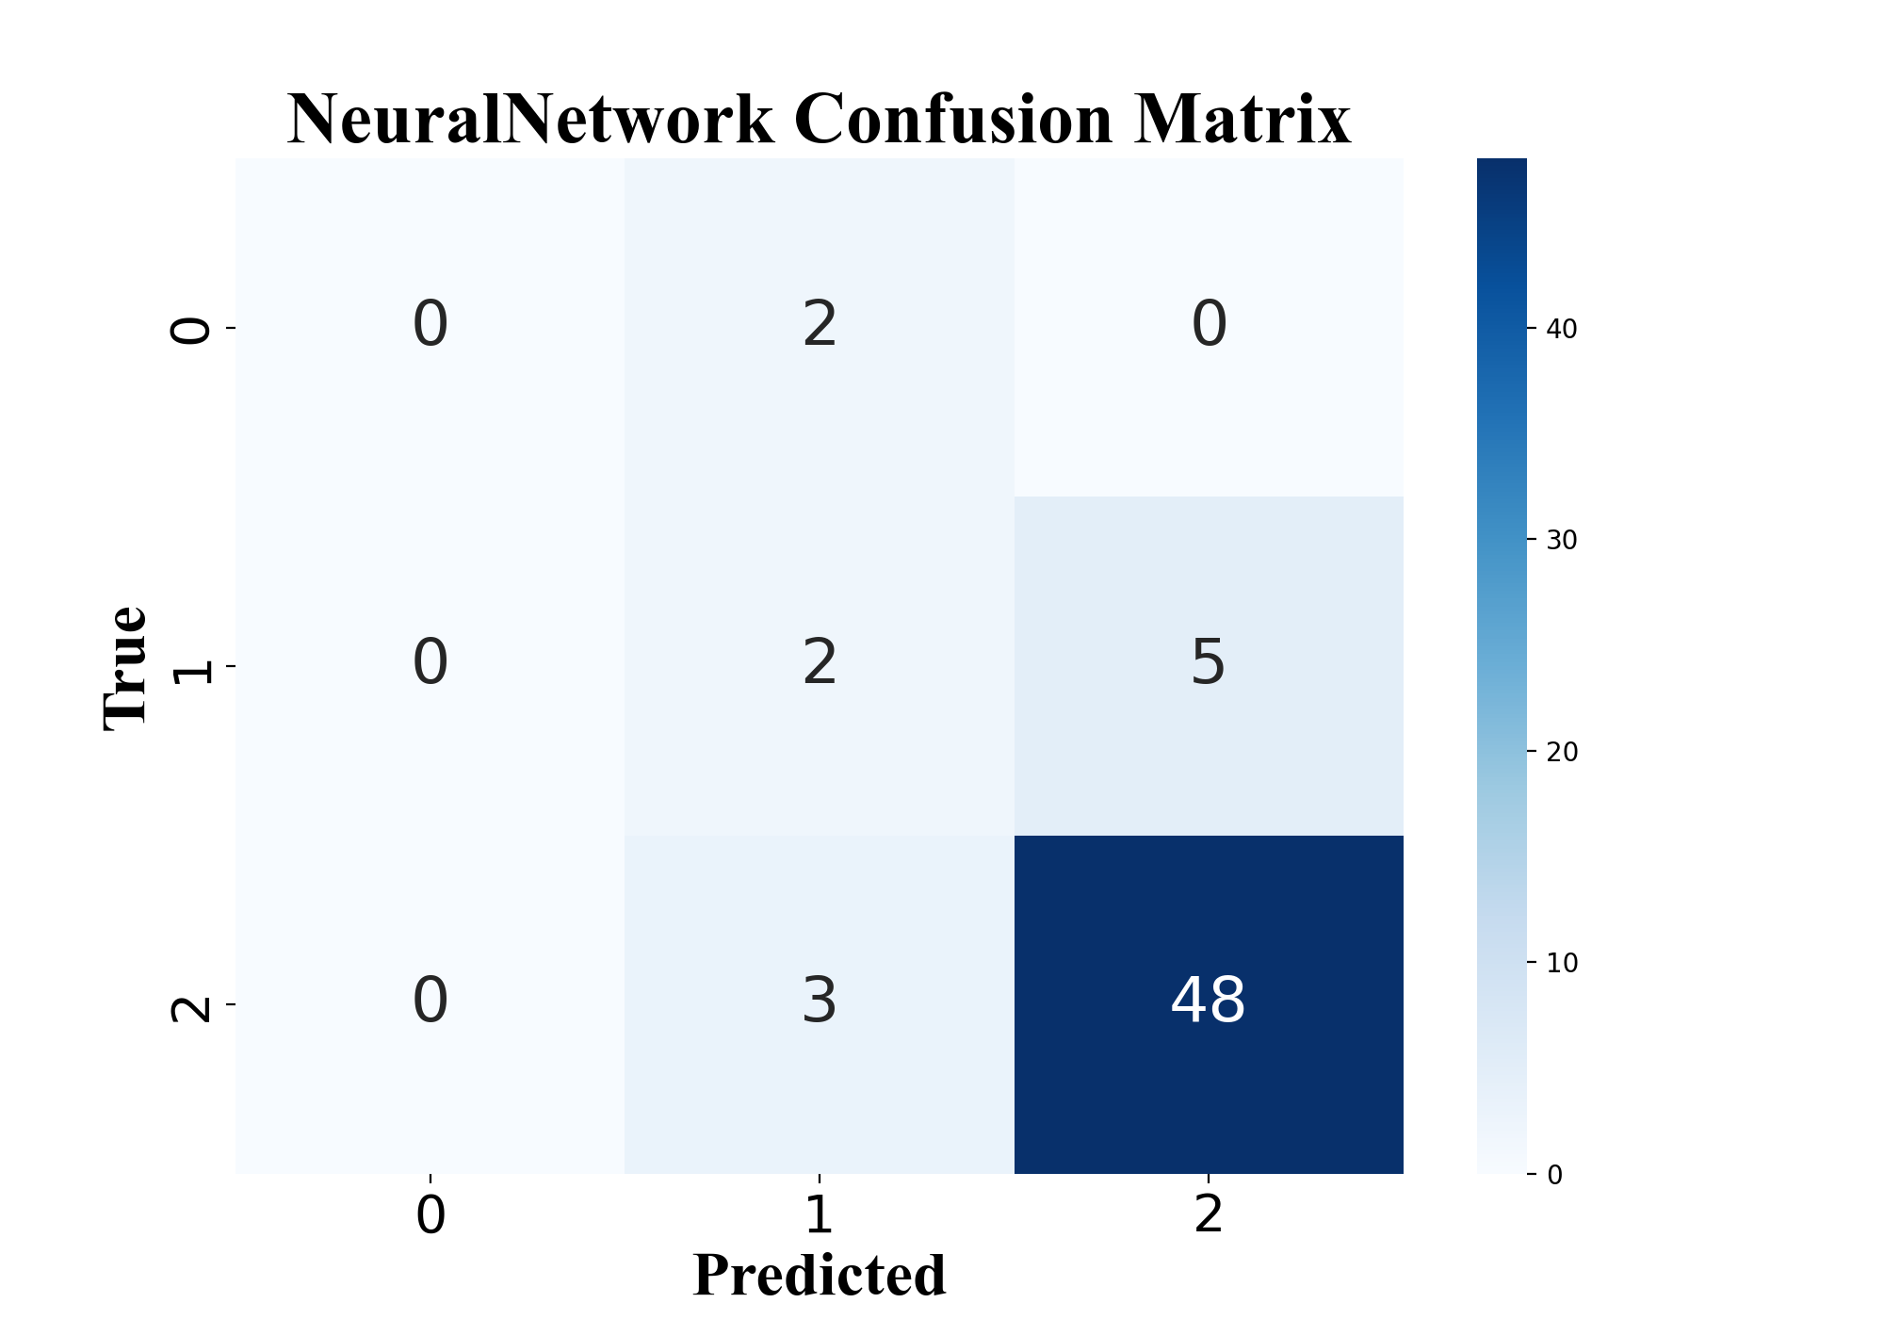
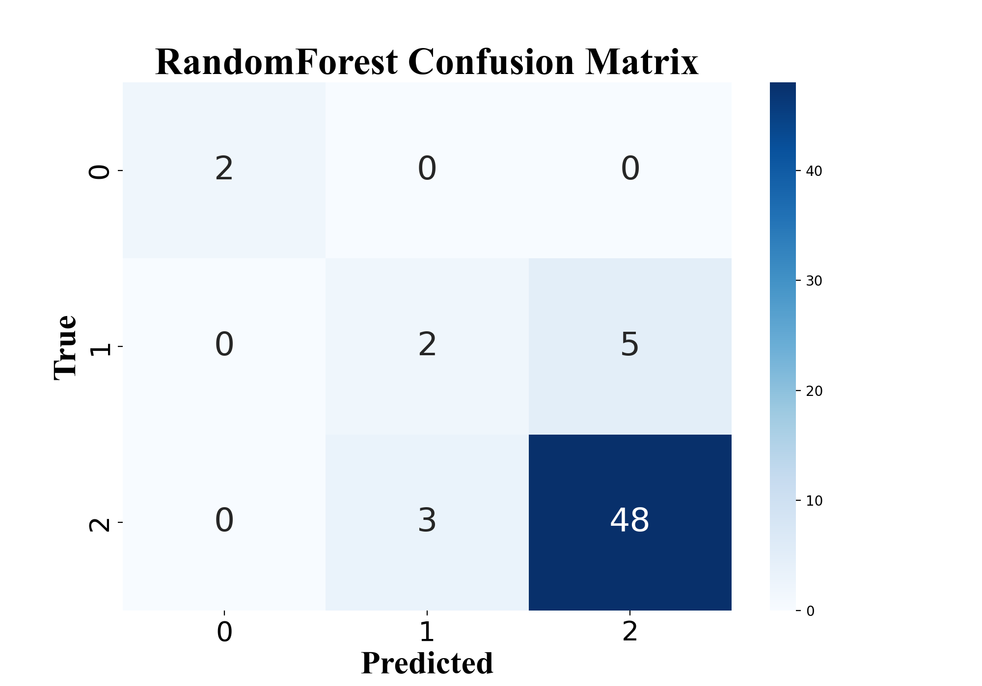
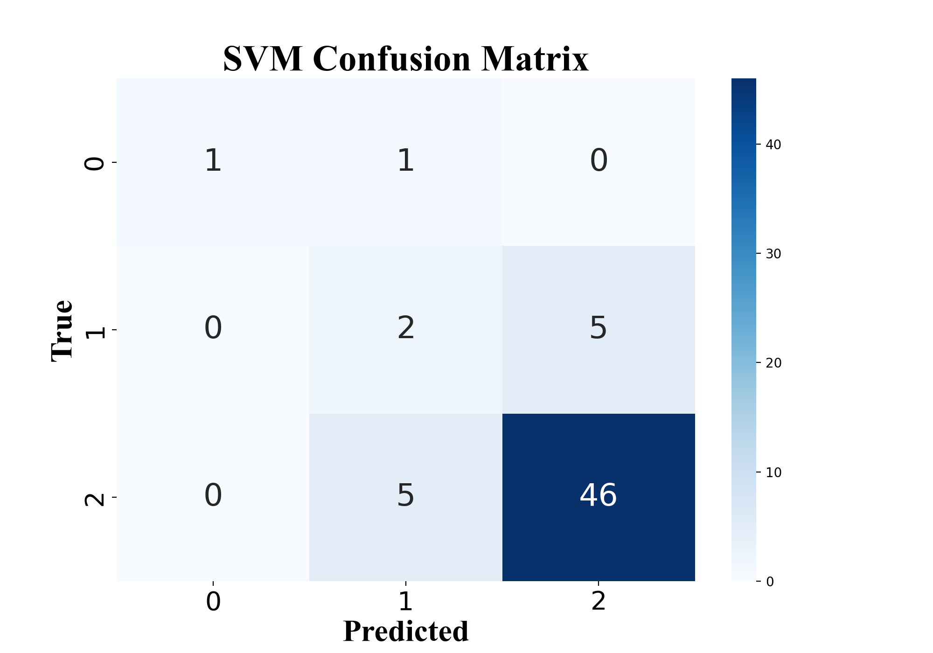
Exercise 2: predict the activity of catalyst → classification
Labeled as 3 classes:
good: 2
medium: 1
fair: 0
SAMPLE RESULTS
rules:
1. deltaH< -0.5: +1
2. postEa< 3.2: +1
Accuracy：83%
Accuracy：87%
Accuracy：82%

Slide 13
Exercise 3: potential energy surface using Gaussian Process
Exercise 4: potential energy surface using Neural Networks

Slide 14
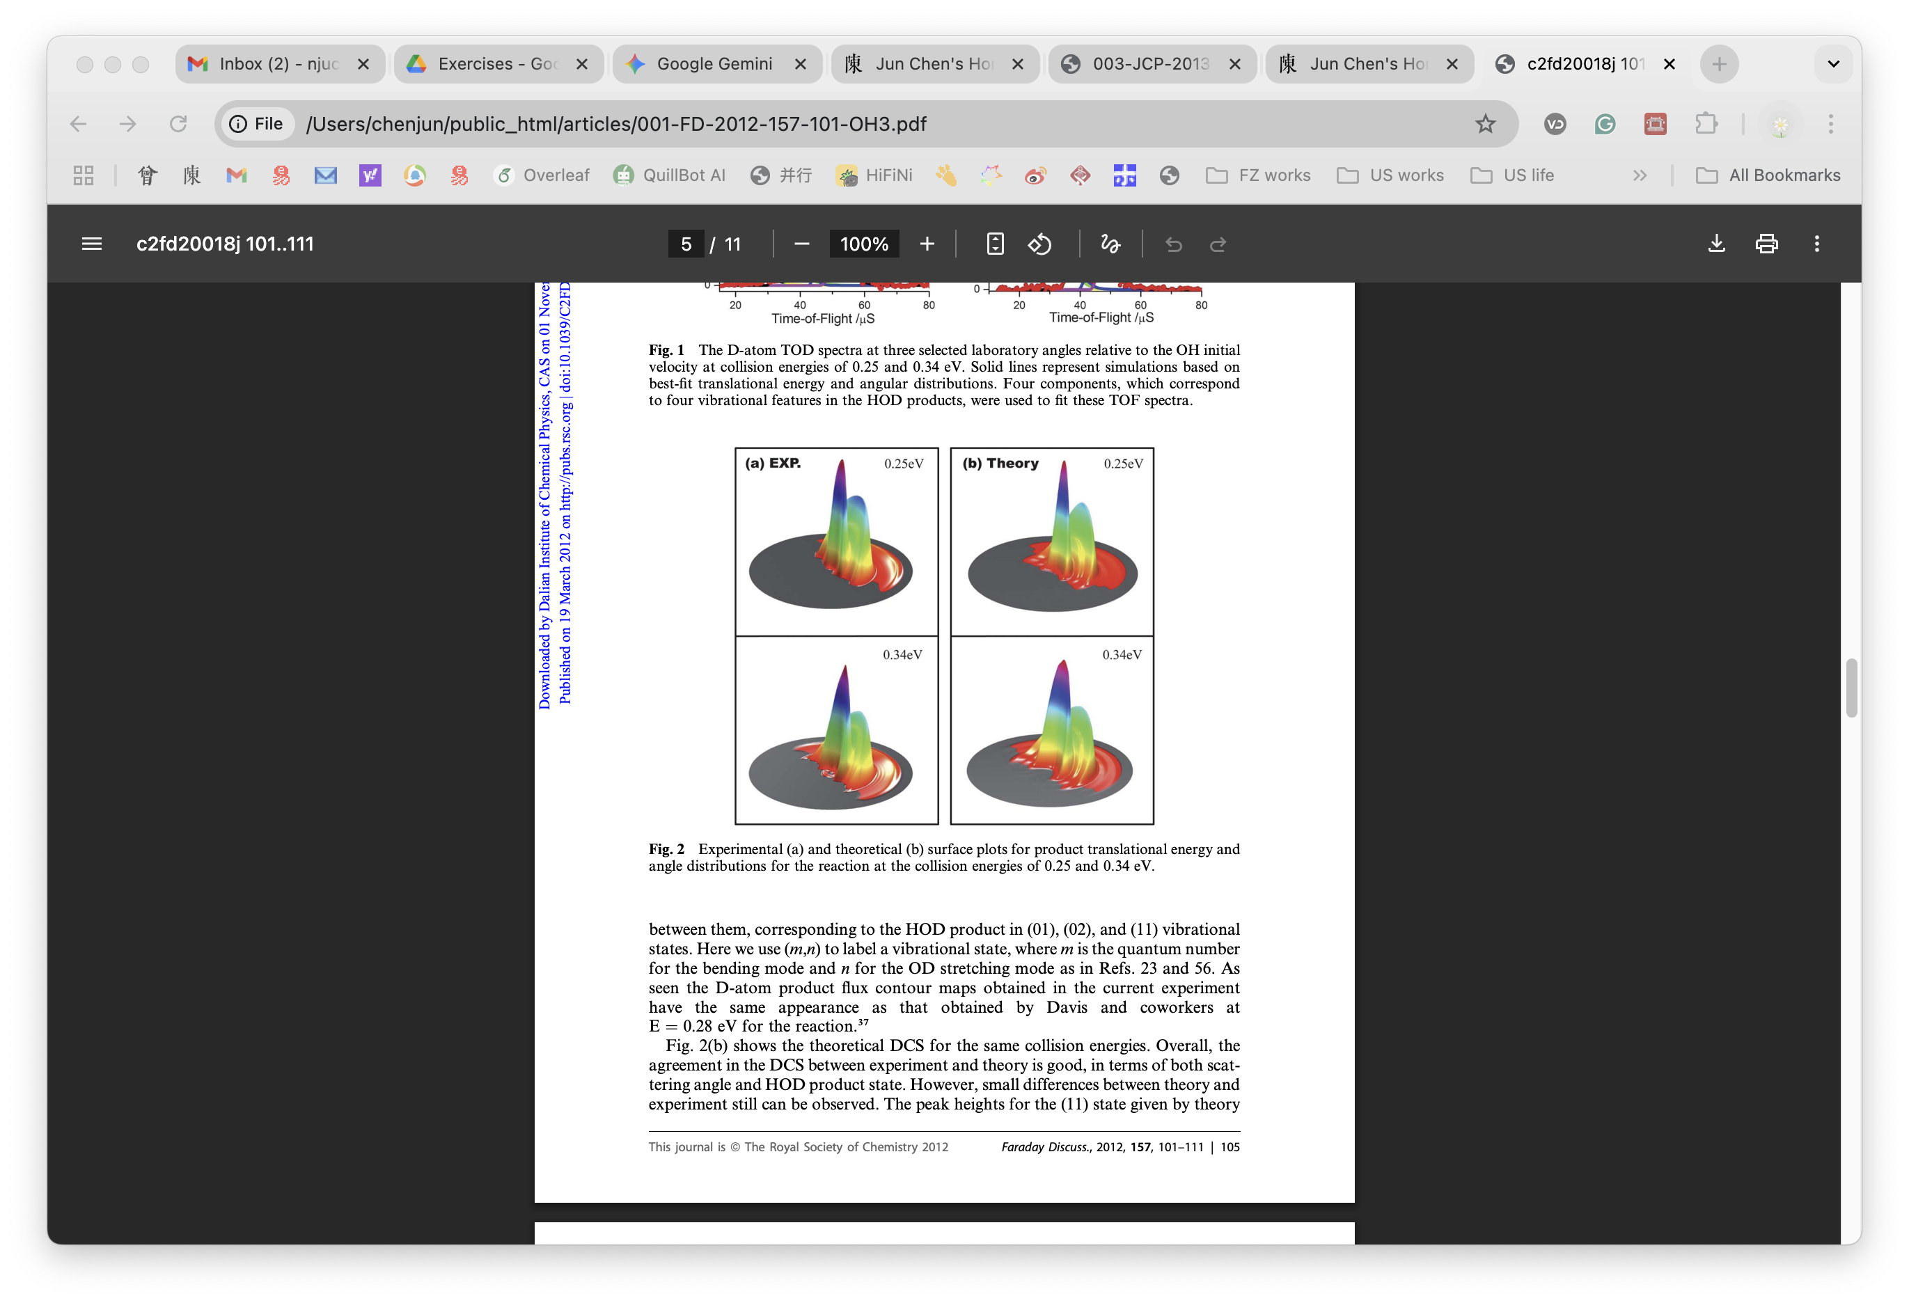
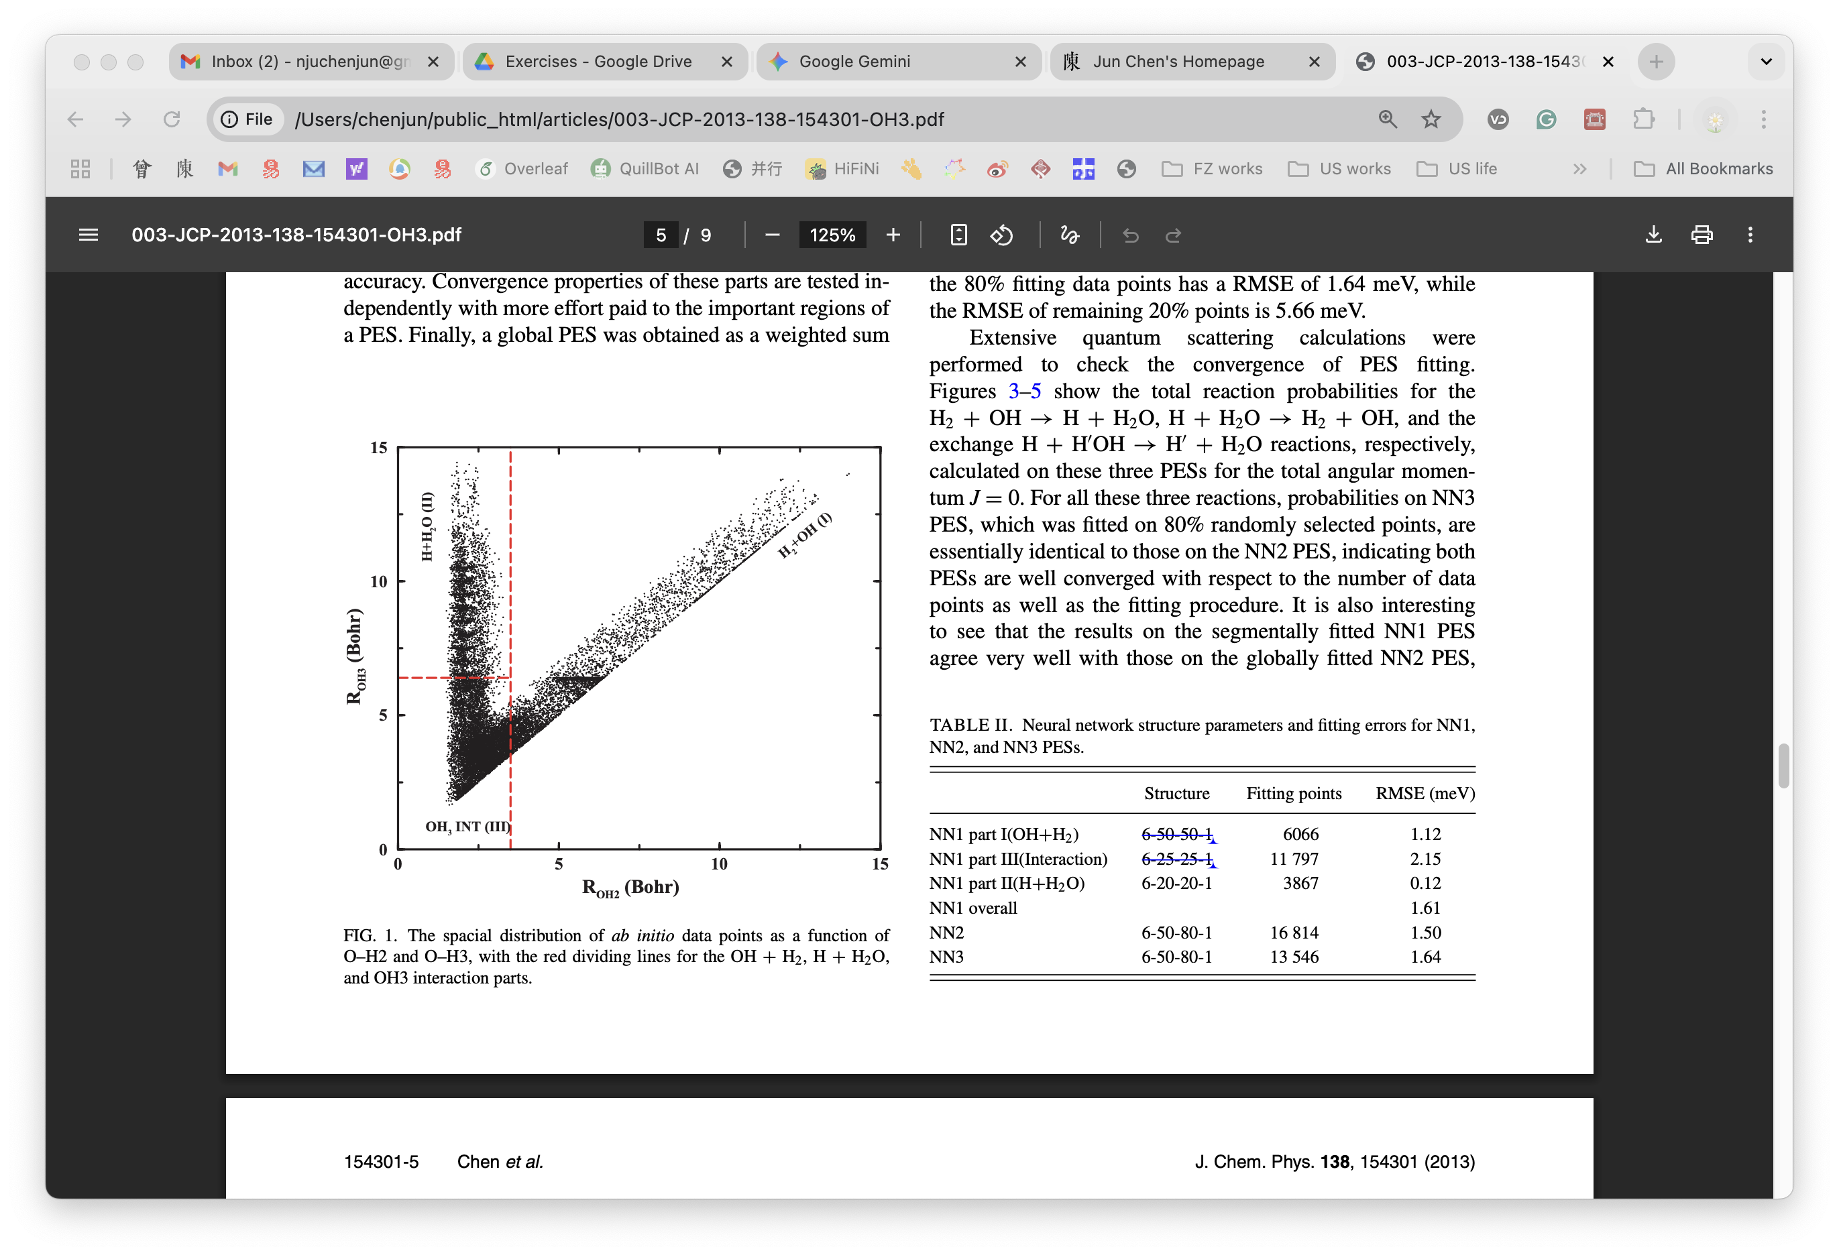
Exercise 3: potential energy surface using Gaussian Process
Exercise 4: potential energy surface using Neural Networks
the OH + H₂ -> H + H₂O reaction
dataset
16814 [structure, energy] points at CCSD(T)-f12a/AVTZ level
2. model
❓choice
Shepard interpolate
PIP fitting
gaussian process
neural networks
❓consider
fitting accuracy
evaluation speed
3. link to dynamics
⚖️
ab initio
level
CPU
cost
J. Chem. Phys., 2013, 138(15): 154301.
Faraday Discussions, 2012, 157: 101-111.

Slide 15
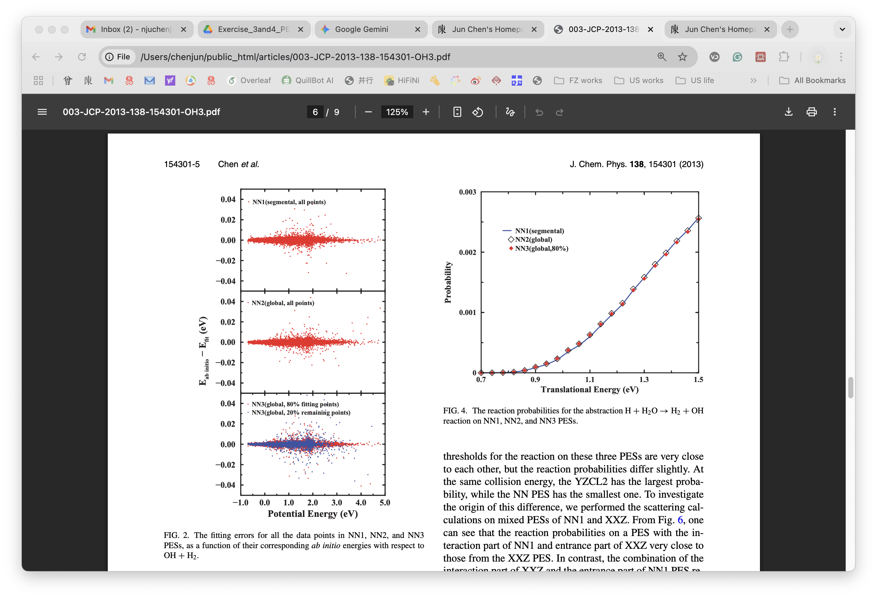
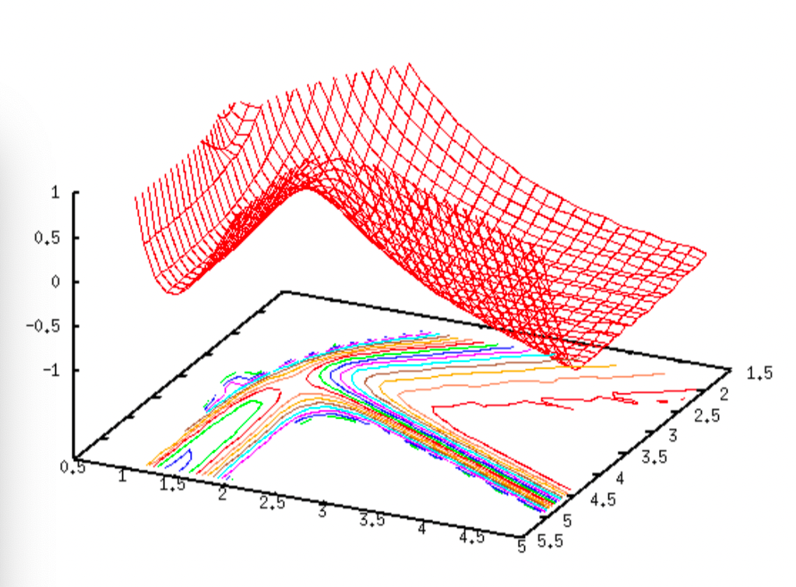
Exercise 3: potential energy surface using Gaussian Process
Exercise 4: potential energy surface using Neural Networks
our goal(s):
1. error distribution plot
2. 2D cut pf PES plot
SAMPLE RESULTS
R(OH-H₂)
R(H-H)
J. Chem. Phys., 2013, 138(15): 154301.

Slide 16
Exercise 3: potential energy surface using Gaussian Process
A. the dataset: oh3-abinitio.txt
columns 1-6: distances / a.u.
O-H1, O-H2, O-H3, H1-H2, H1-H3, H2-H3
O-H1 <= O-H2 <= O-H3
column 7: potential energy / eV
relative to the OH + H₂ asymptotic valley
Discussions:
1. size of training set
2. distrib. of training set
3. the kernel:
covfunc, likfunc, …
4. use R or 1/R
B. scikit-learn, GPflow, GPy, GPyTorch, George
C. a sample code: gp_training.m
use “MATLAB” and the “gpml ” toolbox
do the fit and get a“GPinput.txt”file
use “fortran_gp_pes” to evaluate the PES

Slide 17
Exercise 3: potential energy surface using Gaussian Process
Future works:
Permutation Invariance
SOAP-GAP https://libatoms.github.io/GAP/
construct small dataset for GP
clustering, active learning

Slide 18
Exercise 4: potential energy surface using Neural Networks
A. the dataset: oh3-abinitio.txt
columns 1-6: distances / a.u.
O-H1, O-H2, O-H3, H1-H2, H1-H3, H2-H3
O-H1 <= O-H2 <= O-H3
column 7: potential energy / eV
relative to the OH + H₂ asymptotic valley
Discussions:
1. training/validation set
2. neurons, hidden layers
3. the random number
4. use R, 1/R, or exp(-aR)
5. excitation function:
tansig, logsig, ReLU
B. PyTorch or TensorFlow
C. a sample code: nn_training.tar
use “nn.f” and “FORTRAN ” compiler
compile, then run fittings, and get“W??.txt”files
use “fortran_nn_pes” to evaluate the PES

Slide 19
Exercise 4: potential energy surface using Neural Networks
Future works:
Permutation Invariance
PIP-NN, FI-NN, GNN, atomic-NN
compare with general potentials (MACE / DPA-3)
how the dataset constructed?
active learning

Slide 20
Thank You!
Prof. Dr. Jun Chen
Email: chenjun@fjirsm.ac.cn / njuchenjun@gmail.com
https://orcid.org/0000-0002-8021-7458
https://scholar.google.com/citations?user=zbCkt7gAAAAJ

